Slide 1

Title
Supervisor Research Scholar
Dr.G.Micheal Vijay .T
Professor 192324148
Saveetha School of Engineering Saveetha School of Engineering
CODE OPTIMIZER FOR STUDENT ASSIGNMENTS

Slide 2
AGENDA
Introduction
Existing Model
Limitations of existing Model
Proposed Model
Implementation
Result and discussion
Future Enhancement
Conclusion

Slide 3
INTRODUCTION
Code optimization improves efficiency, readability, and maintainability in student assignments.
Student projects often contain redundant code, increasing execution time and complexity.
The project aims to develop a code optimizer to enhance student submissions.
Focuses on dead code elimination and constant folding for optimization.
Uses data flow analysis and peephole optimization to detect and remove inefficiencies.
Ensures cleaner, more efficient code, promoting better programming practices.

Slide 4
Manual Code Optimization : Students and instructors manually review and refine code.
Basic Compiler Optimization : Compilers perform limited optimizations like constant folding and dead code elimination.
Syntax Checkers and Linters : Tools like IDE-based linters highlight syntax issues but do not deeply optimize code.
Limited Focus on Student Assignments : Most optimization tools are designed for large-scale software rather than educational use.
No Automated Redundancy Removal : Existing models do not actively detect and remove redundant code.
Inconsistent Optimization Approaches : Different tools provide varying levels of optimization, leading to unpredictable improvements.
EXISTING MODEL

Slide 5
FLAWS IN EXISTING MODEL
Time-Consuming : Manual code optimization requires significant effort from students and instructors.
Limited Optimization Scope : Compilers focus on execution efficiency but do not improve code readability or structure.
Not Designed for Student Assignments : Existing tools cater to large-scale software development rather than educational needs.
Lack of Deep Code Analysis : Basic syntax checkers and linters do not detect redundant computations effectively.
No Automated Redundancy Removal : Current models do not actively eliminate dead code or optimize expressions.
Inconsistent Results : Different compilers and IDEs provide varying levels of optimization, leading to unpredictable improvements.

Slide 6
PROPOSED MODEL
Automated Code Optimization : Eliminates redundant code and optimizes expressions without manual intervention.
Dead Code Elimination : Detects and removes unnecessary code that does not impact execution.
Constant Folding : Precomputes constant expressions to improve efficiency.
Data Flow Analysis : Tracks variable usage and removes redundant computations.
Peephole Optimization : Identifies and replaces inefficient code patterns with optimized versions.
User-Friendly Interface : Provides a simple and accessible tool for students to optimize their code easily.
Consistent Optimization : Ensures uniform improvements across different code submissions.
Better Readability and Performance : Produces cleaner, well-structured, and efficient code.

Slide 7
IMPLEMENTATION
Code Input : Accepts student-written code for analysis.
Lexical and Syntax Analysis : Parses the code to understand its structure.
Data Flow Analysis : Identifies redundant computations and unused variables.
Dead Code Elimination : Removes code that does not impact execution.
Constant Folding : Simplifies expressions involving constant values.
Peephole Optimization : Replaces inefficient code patterns with optimized versions.
Code Generation : Produces the optimized code while maintaining functionality.
Final Output : Displays the improved, more efficient version of the student's code.

Slide 8
RESULTS AND DISCUSSION
Optimized Code Efficiency : Dead code elimination and constant folding reduced redundant computations, improving execution speed.
Improved Readability : The optimized code was cleaner and easier to understand.
Performance Metrics : Evaluated based on execution time, memory usage, and code size, showing significant improvements.
Successful Validation : Optimized code produced the same output as the original, ensuring correctness.
Handling of Complex Code : Data flow analysis effectively detected and optimized redundant expressions.
Student Benefits : Helped students write better-structured and efficient code with minimal effort.

Slide 9
FUTURE ENHANCEMENT
Loop Optimization : Reduce unnecessary iterations to improve efficiency.
Strength Reduction : Replace costly operations with simpler alternatives (e.g., replacing multiplication with bit shifts).
Function Inlining : Optimize function calls by replacing them with direct code execution where beneficial.
Multi-Language Support : Extend the optimizer to handle multiple programming languages.
User-Friendly Interface : Develop a GUI for easier access and usability.
AI-Based Optimization : Implement AI techniques to detect and optimize inefficient code patterns automatically.
Cloud-Based Optimization : Enable an online platform for students to submit and receive optimized code instantly.

Slide 10
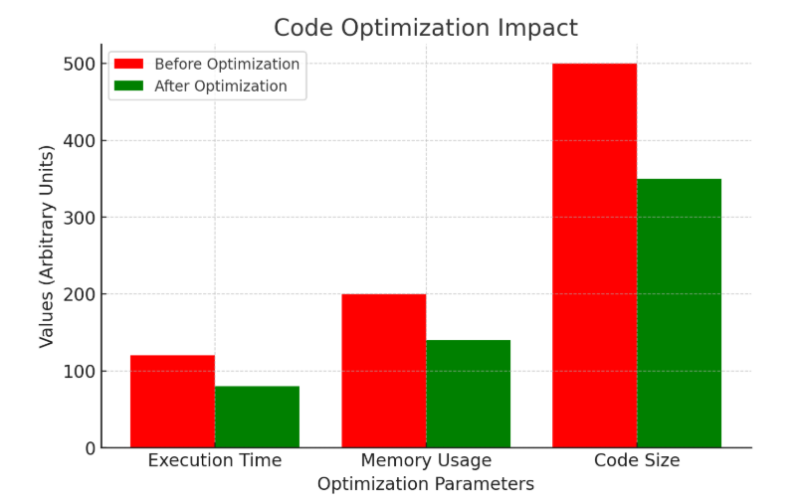
OUTPUT

Slide 11
CONCLUSION
The proposed automated code optimizer enhances execution efficiency and readability of student assignments.
It effectively removes redundant code while ensuring correctness and maintaining the original output.
Performance evaluations show significant improvements in execution time and memory usage.
Future enhancements, including AI-based optimization, multi-language support, and a cloud-based platform, will further improve usability and scalability.

Slide 12
REFERENCES
1. J. Miller, L. Trümper, C. Terboven, M.S. Müller, A theoretical model for global optimization of parallel algorithms, Mathematics 9 (2021)
2.L. Trümper, J. Miller, C. Terboven, M.S. Müller, Automatic mapping of parallel pattern-based algorithms on heterogeneous architectures, in: Architecture of Computing Systems, Springer International Publishing, Cham, 2021, pp. 53–67.
3.Wu, D., Wang, S., Liu, Q., Abualigah, L., & Jia, H. (2022). An Improved teachinglearning-based optimization algorithm with reinforcement learning strategy for solving optimization problems. Computational intelligence and neuroscience, 2022, Article ID 1535957, 24 pages. h

Slide 13
THANK YOU

